Slide 1
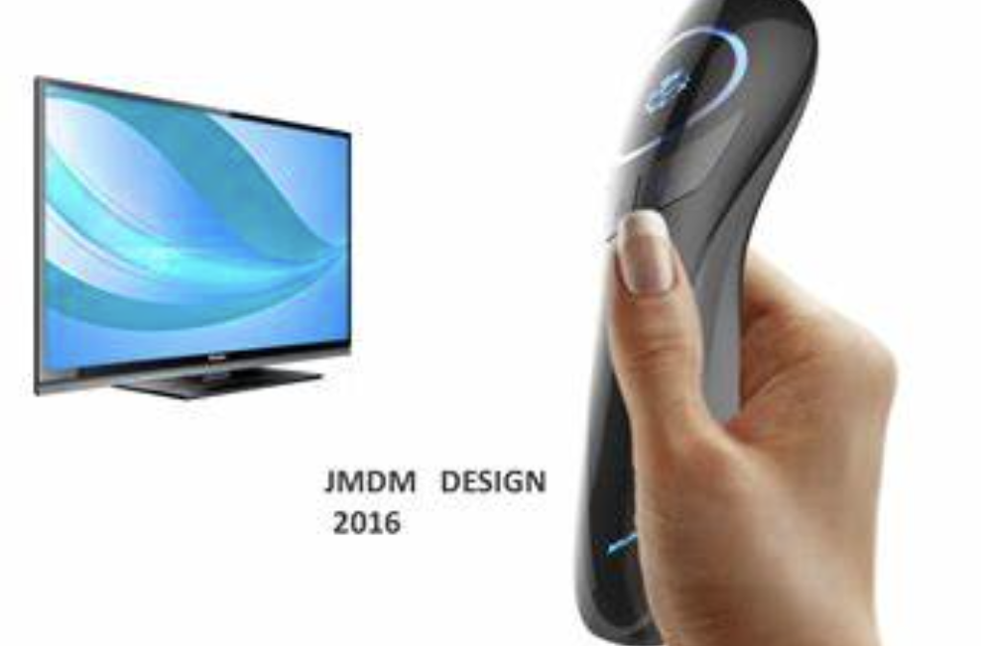
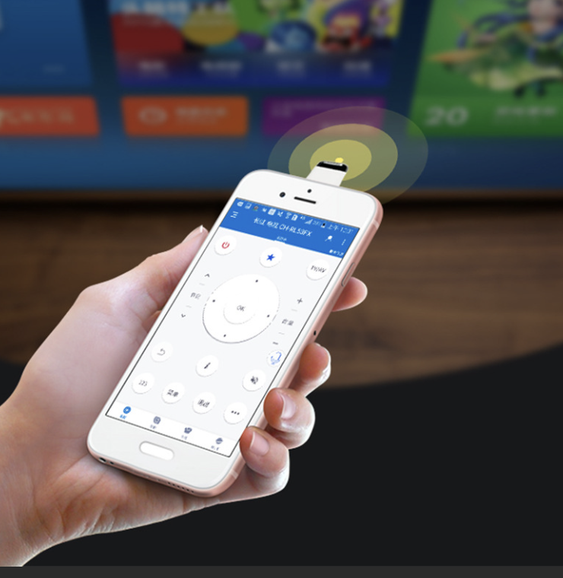

Notes:
Are you still using the remote control? Or a remote control app on your phone

Slide 2
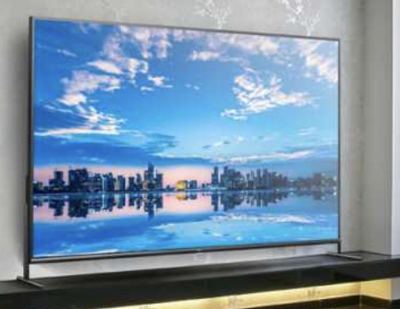
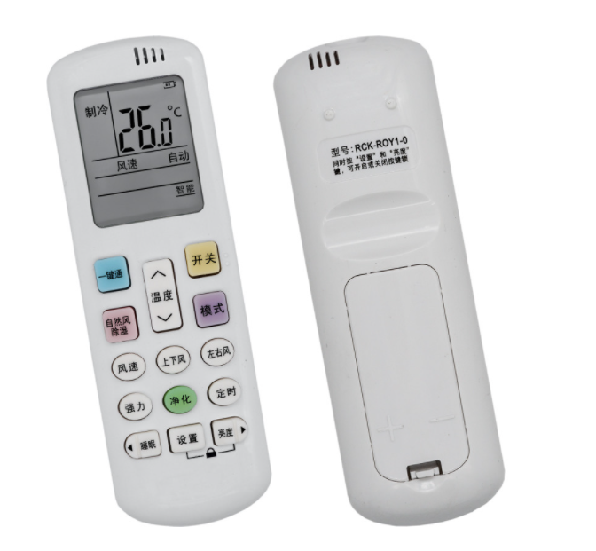
Notes:
Imagine you have a lot of screens, like a TV, a projector, but you can't find the corresponding remote control.

Slide 3
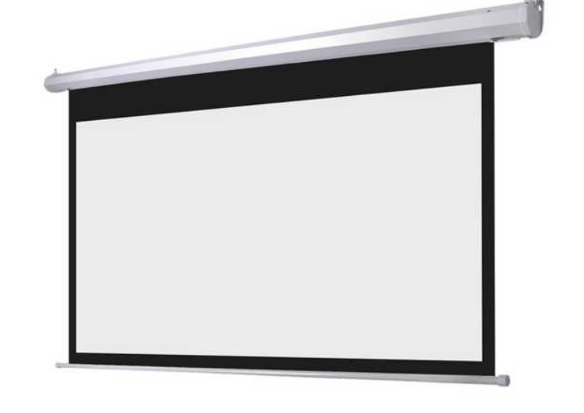

Oh, it’s the remote control for the air conditioner
Notes:
Or you're a lecturer and you need to give a lecture. But you realise you forgot your slide remote. Why not use your hands to control the slides. Our project allows you to make your hand as a remote control.

Slide 4
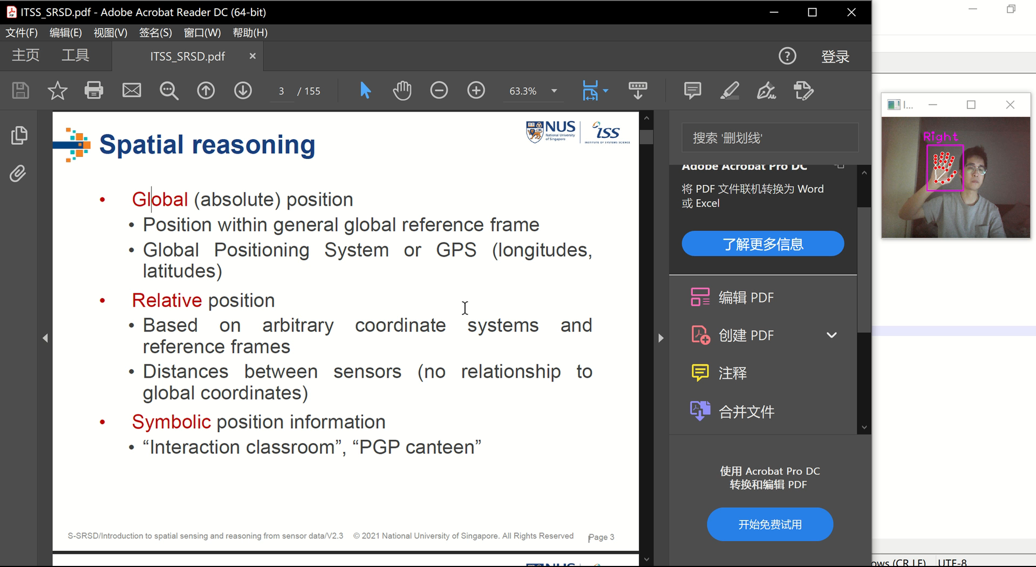
Notes:
You can use your hand, to turn the page up and down

Slide 5
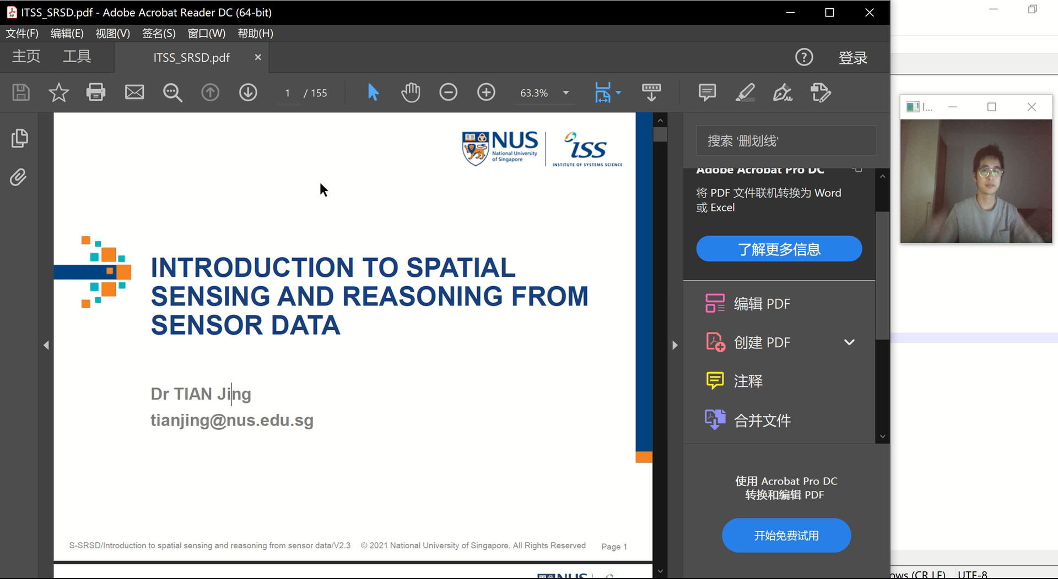
Notes:
You can use your hands, zoom in and out

Slide 6
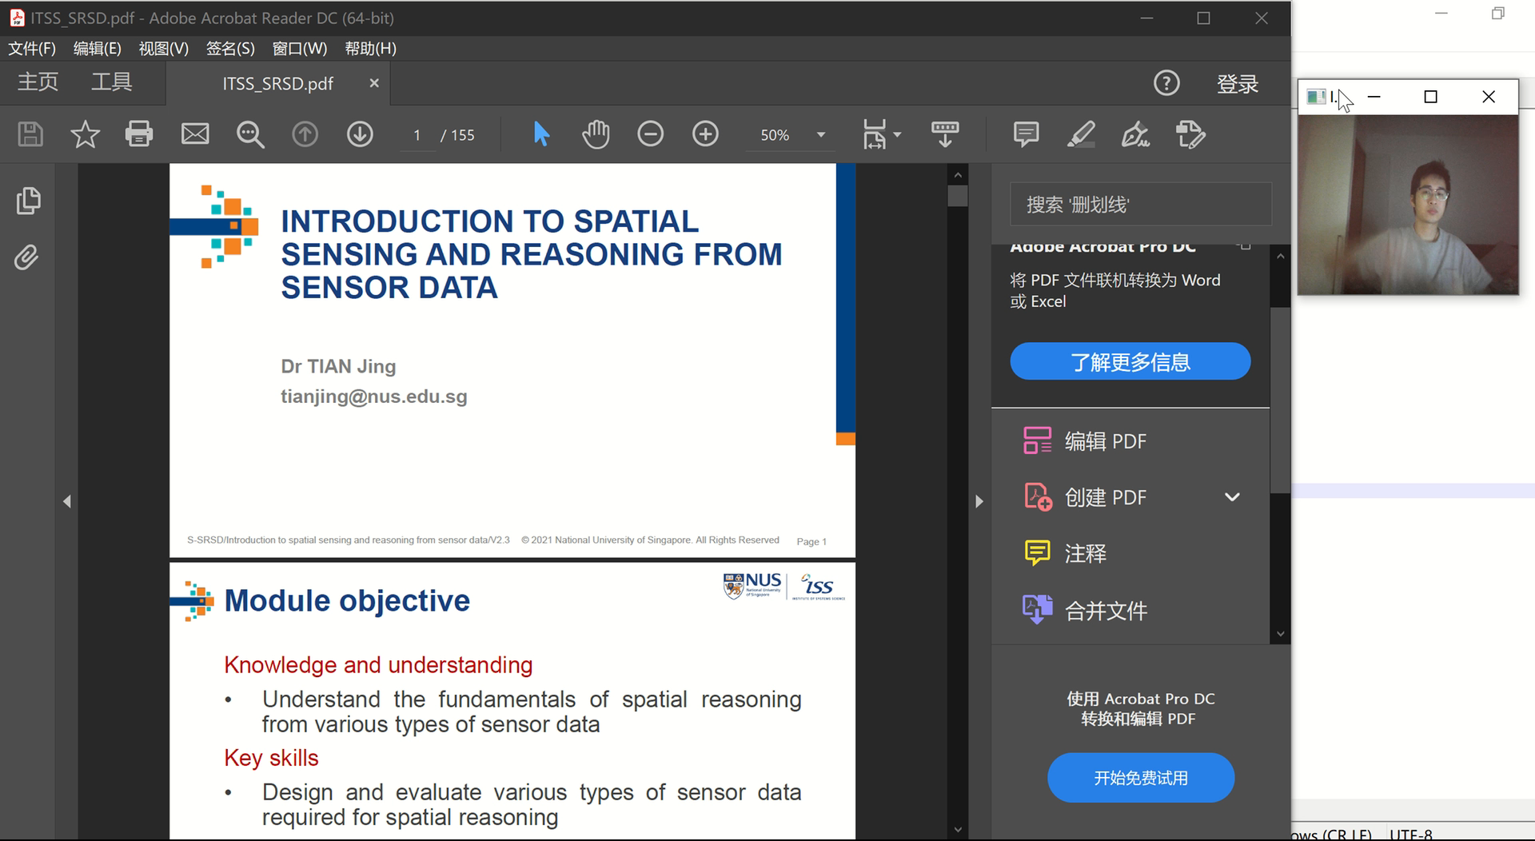
Notes:
OR You can even use both hands to take screenshots

Slide 7
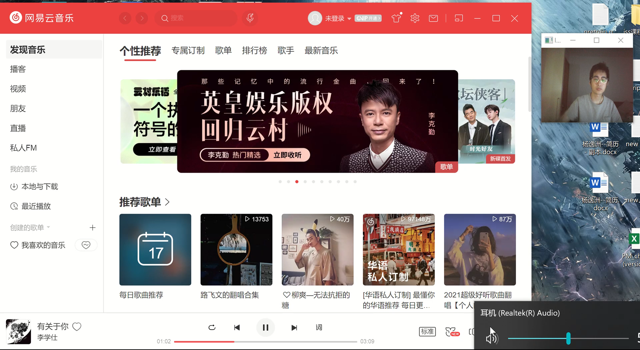
Notes:
Control the volume up and down

Slide 8
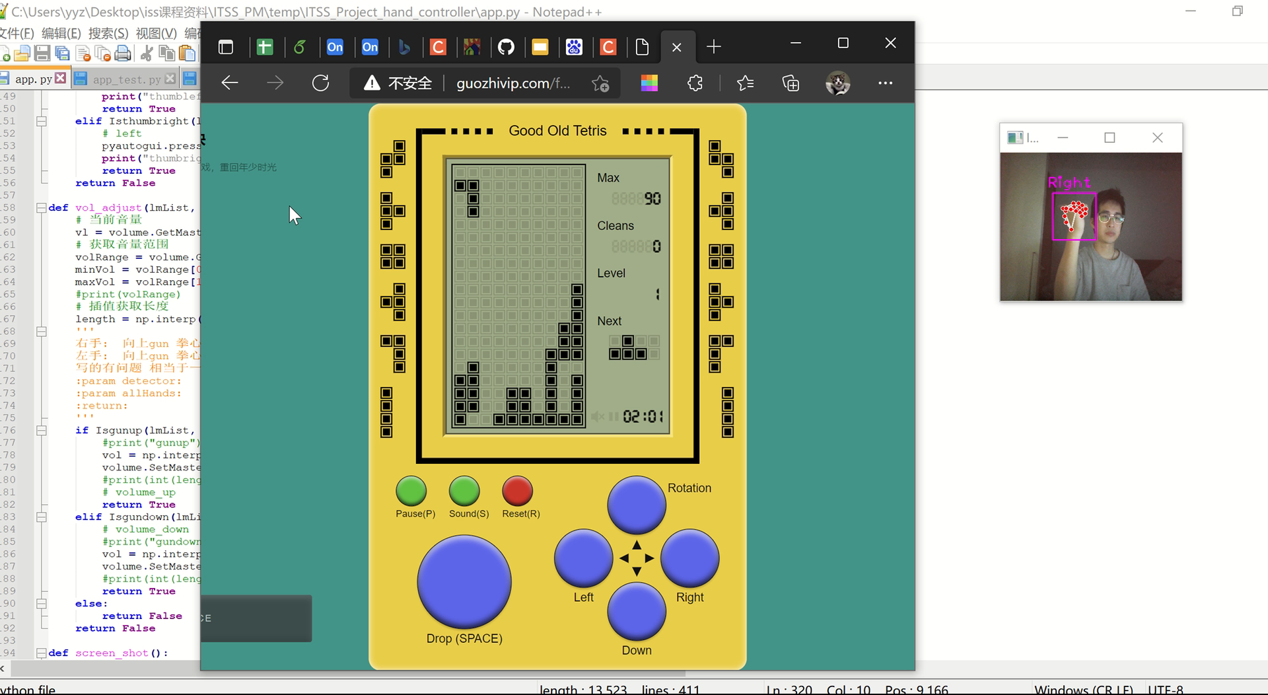
Notes:
Or even playing Tetris.

Slide 9
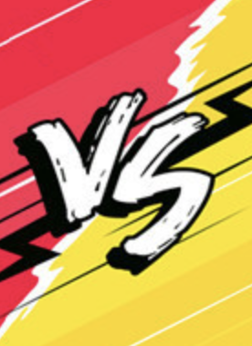
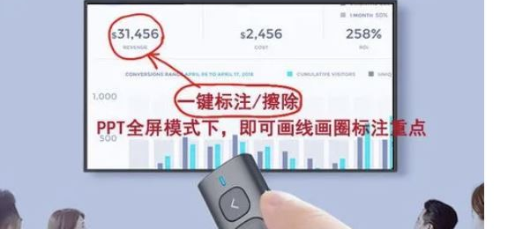
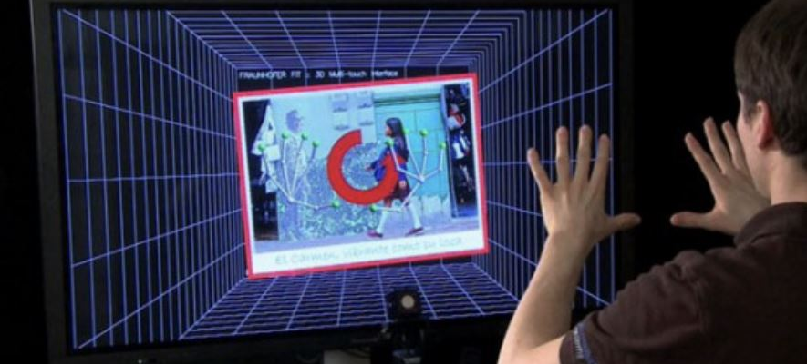
Notes:
Here we provided just a few applications and have really improved the operating experience. Gestures are faster, more convenient and more user-friendly than traditional keyboard and mouse operations. In the future, we believe this change will cover our life.

